Slide 1
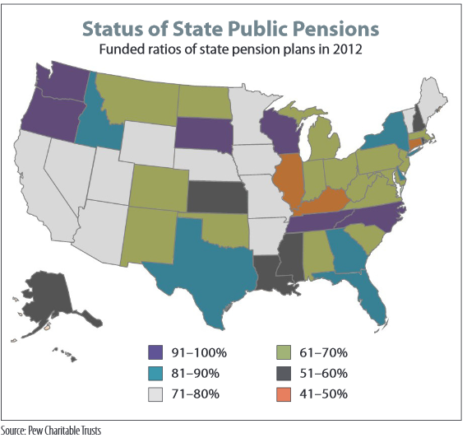

Challenges in Analysing Fiscal Health of Public Pension Plans in the U.S.
(AAOA, 2014)
©grumpus maximus limited 2020

Slide 2


“From the town of Detroit where my job is secure yeah
Secure in the fact now that it's gone for good yeah
So I'll scrimp and I'll scrape at this pension I saved
So it should be gone by the end of the day
Yeah the power's out
Is there no luck in sight?
Yeah the power's out
Hope it's just for the night
Yeah the power's out
Another kick in the head
I'm so poor at this living I'd be richer off ….”
(The Pop Break, n.d.)
— Floggin’ Molly, The Power’s Out from the Speed of Darkness Album, 2011

Slide 3
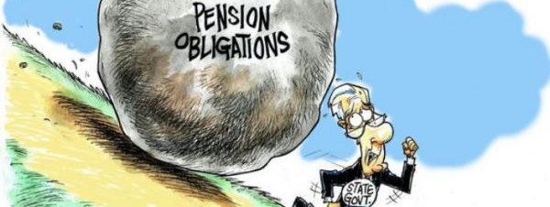
How Safe Is My Public Pension?
This Photo by Unknown Author is licensed under CC BY

Slide 4

How Most (Non-Federal) U.S. Public Pension Plans (PPPs) Work
What they do:
  Pay annuitants a defined benefit (amount) in “retirement” (DOL, 2020)
  Agreed to in advance – legal protections vary by state (Farmer, 2014)
  Typically based on years worked and average salary
How they fund it:
  Tax payer and (sometimes) worker contributions (Aubrey & Wandrei, 2019)
  Investment returns (Aubrey & Wandrei, 2019)
  What’s the risk?
  Annuitant longevity – lifespans getting longer (AAOA, 2016)
  Market volatility – annuitants paid every month regardless (Moran, 2013)
This Photo by Unknown Author is licensed under CC BY-SA

Slide 5
Speaking of PPPs and
Funding
U.S. PPPs:
  5,420 plans at state an local level (Census Bureau, 2019)
  $4.3 trillion in assets (Census Bureau, 2019)
  Covering 21.1 million former and current workers (Census Bureau, 2019)
  2019: 71% = projected funding avg. (Aubrey et al., 2020)
2019 PPP projected funded ratio:71%
(Aubry et al., 2020)
Notes:
Let me start by laying a quick baseline of knowledge. For the remainder of the brief, when I refer to a pension, I am specifically referring to a Defined Benefit Pension (DBP). According to the U.S. department of Labor, a DBP provides a monthly amount of pay to a retired worker for the remainder of their life. Those payments come from pension plans which are typically funded by the retiree’s employer, but may have been additionally funded by the worker. Money contributed to pension funds is typically invested in bonds, stocks, real estate, alternatives, and private equity. Some of those investments are riskier than others, and in an ideal world pension, fund managers stick with the less risky investment.
This brings up the issue that is very much at the heart of this presentation. While DBPs are an integral part of millions of retirees retirement savings, there is a problem because most pension plans are underfunded. This is true for both corporate and non-federal U.S. government pensions like those at the state and city level.
In the corporate sector there are over 45K DBPs covering nearly 35 million workers or retirees with a total of $3.2 trillion dollars in assets. Of the two types of corporate pensions, the multi-employer plans (MEPs) which are largely unionized pensions, are the worse off. At the end of 2019, they were only funded at an average of 85% with a funding shortfall of $100 billion for future obligations. The top 100 Single Employer Pensions (sponsored by individual companies like GE or FED EX) were in a slightly better position at the end of 2019 with an average funding of 87.5%. That sad, they faced a nearly $232 billion shortfall in future obligations.
Public sector pensions for state and local government workers, which cover over 21 million workers and retirees, are worse off on average. They ended 2019 with a projected average funding ratio against future obligations of 71%. Of course, it’s important to keep in mind that these are averages. Many corporate and public pension funds are healthy, and proper analysis is only done on a plan by plan basis.

Slide 6
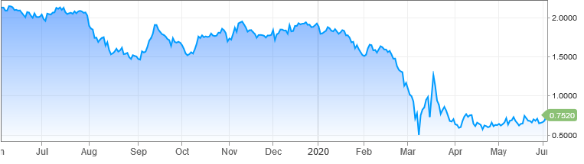
Three Major Challenges in Reporting PPP Fiscal Health
Uncertainty – the realm of actuarial science (Moran, 2013)
  Lifespans: unexpected longevity = unsecured liabilities = drain on assets
  Rate of Return (RR): positive assumptions downplay future liability
  Inflation: natural increase in price of goods over time impacts real RR
Politics
  Unfunded additional benefits (AAOA, 2012)
  Required annual contributions conditional on state/local budgets
  Taxes or borrowing? (Norcross & Gonzalez, 2018)
Fiscal policy (AAOA, 2012)
  Inverse relationship between int. rates and liabilities
  Rates down = greater unsecured liabilities
  Requires more contributions or better RRs
10-year U.S, Treasury Yield (CNBC, 2020)
(Aubry & Wandrei, 2019)
(Norcross & Gonzalez, 2018)

Slide 7

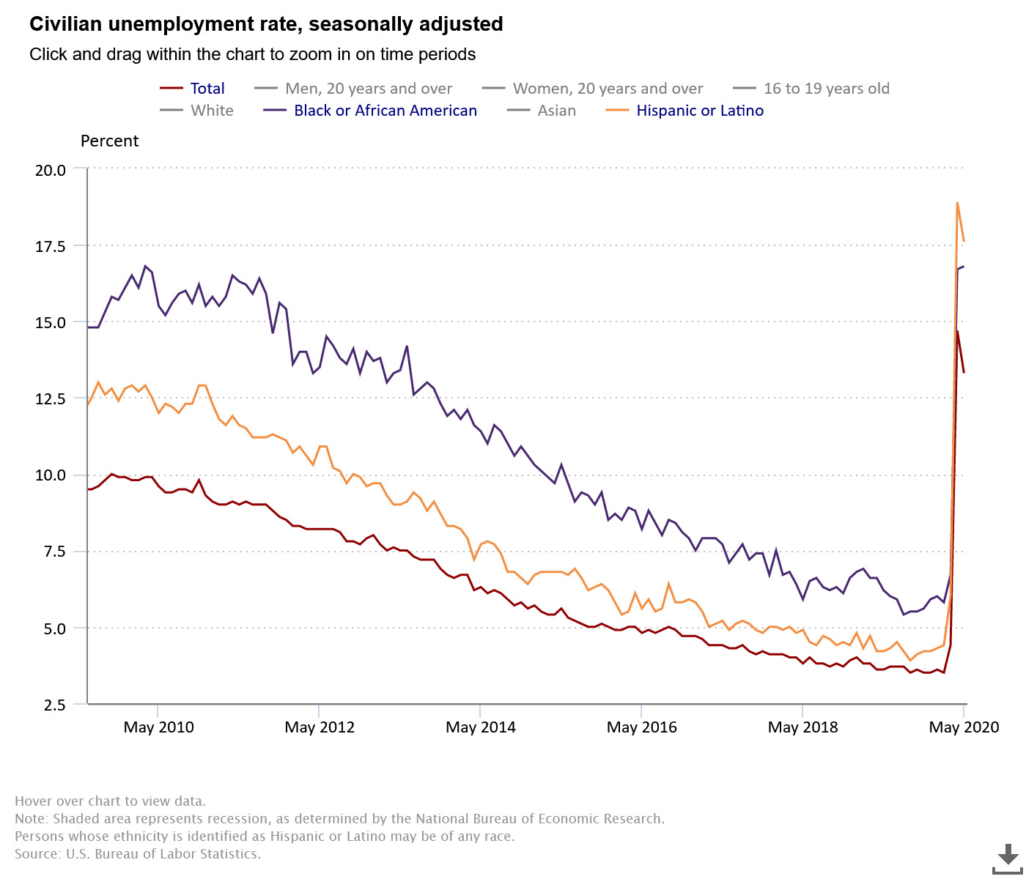

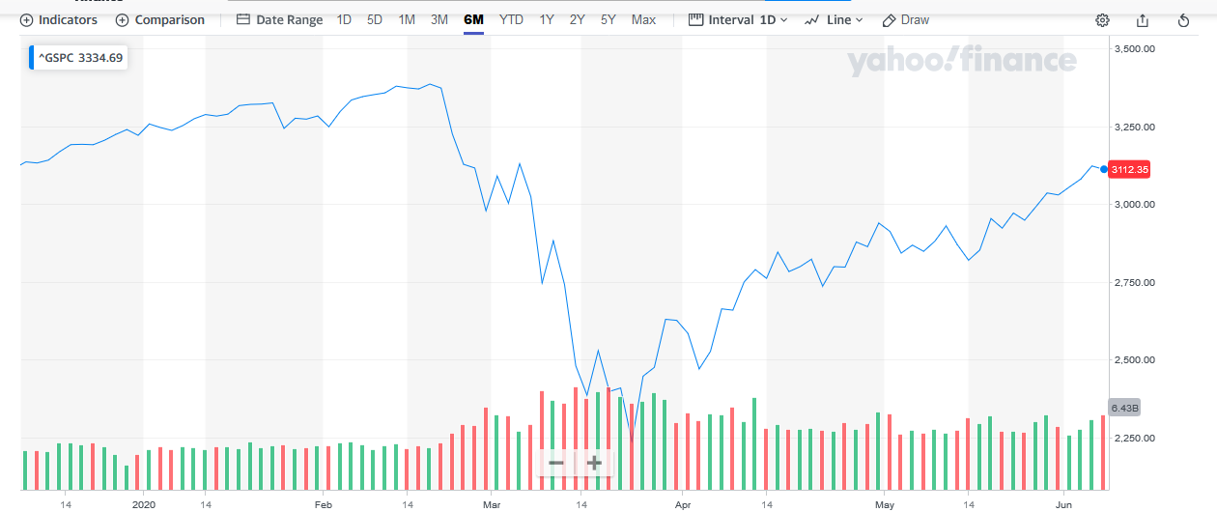
Then COVID-19 Hit!
Fiscal policy: U.S. Interest rate cuts (AAOA, 2012)
  Inverse relationship between int. rates and liabilities
  Requires more contributions or better investment returns
Investment Volatility
  U.S. DBP portfolios composed of 40% to 50% stocks (CRR, 2020; Panis & Brien, 2015; Census Bureau, 2018)
  S&P 500 crashed 33.9% Feb – Mar 2020 (Yahoo Finance, 2020)
  5 Jun 2020 recovered to ~ 8% from Feb 2020 highs (Yahoo Finance, 2020
U.S. unemployment rate (BLS, 2020)
  April 2020: 14.7% -- highest rate since Great Depression
  May 2020: 13.3% -- varies by ethnicity
10-year U.S. Treasury Yield (CNBC, 2020)
Image by Sumanley xulx from Pixabay
1-Year S&P 500 Chart (Yahoo Finance, 2020)
Image by Alexey Hulsov from Pixabay
Combined, African-American, and Latino Unemployment (BLS, 2020)
Notes:
Of course, the COVID-19 pandemic has not helped the pension funding issue at all. The worst impact came from the U.S. Federal Reserve Bank’s interest rate cut for government treasury bonds in early March. For actuarial reasons that I won’t get into, when interest rates are cut, unfunded liabilities go up for pension funds.
When this happens, it means pension fund sponsors must increase their pension fund contributions, and/or pension fund managers must turn to riskier investments, like stocks, to achieve a higher rate of return than bonds can provide. However, the pandemic caused the U.S. stock market to crash in late February through most of March. At one point the S&P 500, the primary indicator of corporate health in America, had almost 34%. It has since recovered to just under 8% low from the February 2020 highs.
Let’s not forget that the unemployment rate spiked in March and April as well, as layoffs and furlough caused by shelter in place orders at the state level took their toll nationwide. April 2020’s 14.7% unemployment rate was the highest seen since the Great Depression, although May’s rate appears to have recovered to 13.3%.
As I already said, none of this is good, and it has a lot of pensioners, and worker’s in pensionable career fields, scared or worried about the safety of their pension.

Slide 8
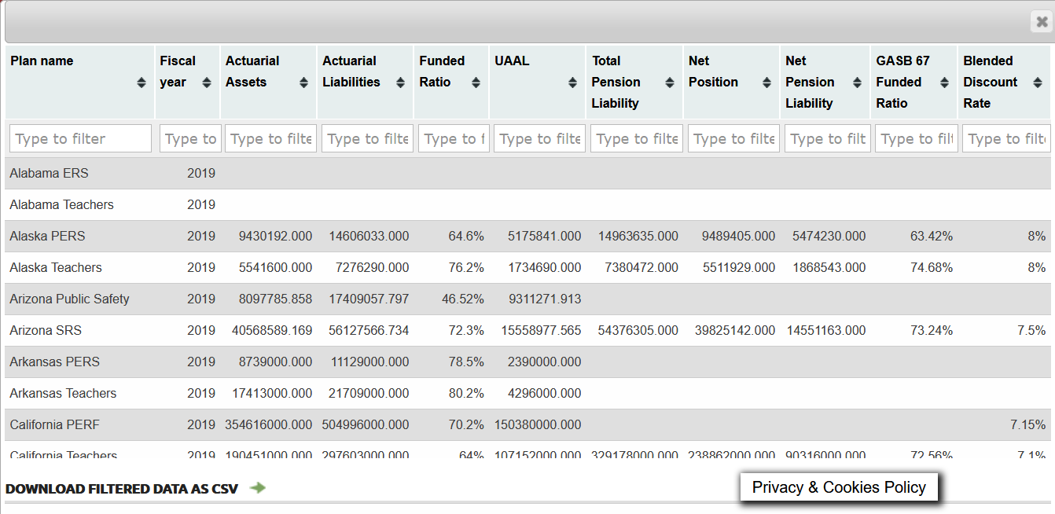
The Data
Public Plans Data (PPD) @ Boston College’s Center for Retirement Research (CRR)
  Plan-level data for 190 state and local PPPs through FY 2019 (CRR, 2020)
  Sample for ~6000 PPPs
  100+ variables with annual data since 2001 (CRR, 2020)
Joint effort between CRR and …
  Center for State and Local Government Excellence
  National Association of State Retirement Administrators
Updated annually ~March (CRR, 2020)
  Comprehensive Annual Financial Reports (CAFRs)
  Actuarial Valuations (AVs)
(CRR PPD, 2020)
Notes:
Imitation game greatly simplified an extremely complex effort to break German Codes during WWII.

Slide 9
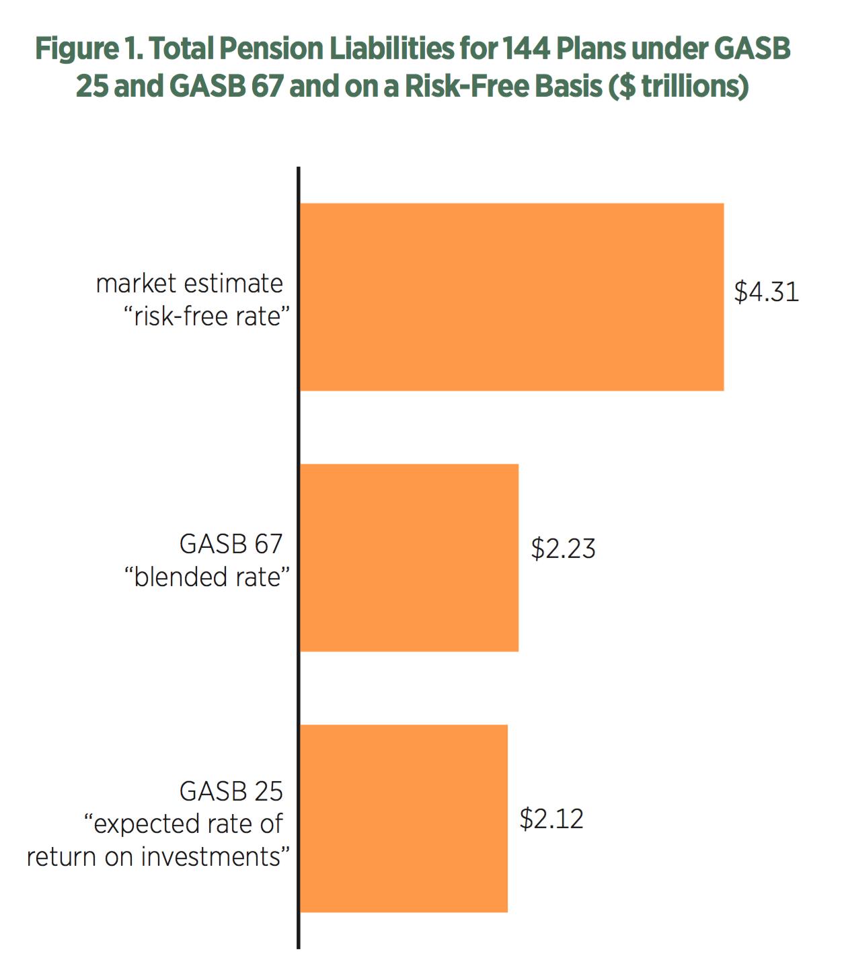
GASB 25 & 27 vs. 67 & 68
  Government Accounting Standards Board (GASB)
    2012 new PPP reporting guidance (Weinberg & Norcross, 2017)
    GASB 25 & 27 to GASB 67 & 68 (Weinberg & Norcross, 2017)
  3 goals of GASB 67 & 68 (Weinberg & Norcross, 2017)
  Eliminate actuarial smoothing (i.e. loss or gain carryover)
  Require full disclosure of unfunded liabilities
  Improve calculations used to project cost of future liabilities
Net effect: small; too many loopholes (Weinberg & Norcross, 2017)
  2019: GASB 25 = 73.5%; GASB 67 = 73.4%
The third way: riskless rate using U.S. treasuries (Munnell et al., 2012)
FY14 144 Plans Total Pension Liabilities in Trillions
(Weinberg & Norcross, 2017)
Market estimate
“risk free rate”
$4.31
GASB 67
$2.23
GASB
25
$2.12

Slide 10
Is There a Better Way to Evaluate Fiscal Health?
2012: American Academy of Actuaries (AAOA)
    “A plan’s funded ratio … is merely a financial snapshot of a plan’s status at a single moment.”
    “The movement or trend of the funded ratio is as important as the absolute level”
Funded ratio most meaningful when viewed together with (AAOA, 2012):
    “Size of the pension obligation relative to financial size of plan”
    Financial health of the plan sponsor
    Funding track record and contribution policy
    Investment strategy including volatility risk and effect on contributions
Examine each factor over years considering the economic environment (AAOA, 2012)
2019 projected aggregate actuarial funded ratio:
71%
(Aubry et al., 2020)

Slide 11
References
American Academy of Actuaries (AAOA). (2016, October). Pension risk transfer. https://www.actuary.org/content/pension-risk-transfer-0
American Academy of Actuaries. (2012, July). American academy of actuaries: the 80% pension funding myth. Actuary.org. https://www.actuary.org/node/13461 .
Aubry, J.-P., & Wandrei, K. (2019, September). Investment update: how do public plans value their assets? Center for Retirement Research. https://crr.bc.edu/briefs/investment-update-how-do-public-plans-value-their-assets/ .
Aubry, J.P., Munnell, A. H., & Wandrei, K. (2020, May). 2020 update: market decline worsens the outlook for public plans. Retrieved May 22, 2020. https://publicplansdata.org/2020/05/12/2020-update-market-decline-worsens-the-outlook-for-public-plans/
Center for Retirement Research. (2020). Downloadable data. Center for Retirement Research. https://publicplansdata.org/public-plans-database/download- full-data-set/.
Center for Retirement Research. (2020). Public plans data. Center for Retirement Research. https://crr.bc.edu/data/public-plans-database/ .
Center for Retirement Research. (2020). Public plans data: national data. Public Plans Data. https://publicplansdata.org/quick-facts/national/ .
Chrispricephotogrphy. (2011, November 10). The Power's Out - Flogging Molly. YouTube. https://www.youtube.com/watch?v=ewtrtxpyX6A
CNBC. (2020, June 3). US10Y: U.S. 10 year treasury. CNBC. https://www.cnbc.com/quotes/?symbol=US10Y .

Slide 12
References
Farmer, L. (2014, January 28). How are pensions protected state-by-state? https://www.governing.com/finance101/gov-pension-protections-state-by- state.html.
Moran, A. E. (2013). "De-risking"-more employers use lump-sum payouts options to decrease their defined benefit plan liabilities. Employee Relations Law Journal, 39(1), 78-82. https://search-proquest-com.nmit.idm.oclc.org/docview/1366391692?accountid=40261
Munnell, A. H., Aubry, J.-P., Hurwitz, J., & Quinby, L. D. (2012, September). How would GASB proposals affect state and local pension reporting? Center for Retirement Research. https://crr.bc.edu/working-papers/how-would-gasb-proposals-affect-state-and-local-pension-reporting-2/
Munnell, A. H., Wandrei, K., & Aubry, J.-P. (2020, May). 2020 update: market decline worsens the outlook for public plans. Center For Retirement Research Public Plans Data. https://publicplansdata.org/2020/05/12/2020-update-market-decline-worsens-the-outlook-for-public-plans/ .
Norcross, E., & Gonzalez, O. (2019, November 15). Ranking the states by fiscal condition. Mercatus Center at George Mason University. https://www.mercatus.org/publications/urban-economics/state-fiscal-rankings.
U.S. Census Bureau. (2019, June 26). 2018 annual survey of public pensions: State & local tables. Retrieved May 22, 2020. https://www.census.gov/data/tables/2018/econ/aspp/aspp-historical-tables.html&data

Slide 13
References
U.S. Department of Labor. (n.d.). Types of retirement plans. Retrieved May 14, 2020, from https://www.dol.gov/general/topic/retirement/typesofplans.
Weinberg, S., & Norcross, E. (2019, September 15). GASB 67 and GASB 68: what the new accounting standards mean for public pension reporting. Mercatus Center at George Mason University. https://www.mercatus.org/publications/urban-economics/gasb-67-and-gasb-68-what-new-accounting-standards- mean-public-pension.

